Slide 1
GRNFanzone

Slide 2
About Us

Slide 3
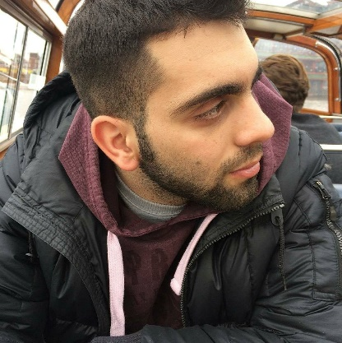
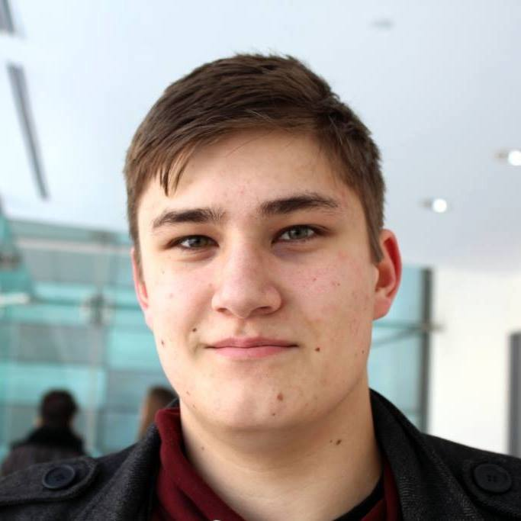



TEAM V
Marios Constantinou
Andrew McCluskey
Ruxandra Bob
Arnas Kapustinskas
Daniel Juranec

Slide 4

OUR CLIENTS
04
GRN
GLOBAL RUGBY NETWORK
Global Rugby Network
Global Rugby Network is a free team management software for rugby teams around the world.
Its aim, is to provide support to coaches, in order to create stronger, healthier and more successful teams.
Team consists of 7 members, all privileged enough to have played rugby on both professional and semi-professional teams.
Dave Millard, founder and CEO
Stefan, CTO
Cham, Lead Software Engineer

Slide 5

PROJECT MOTIVATION
04
FanZone – An Online Rugby Platform
Developed as a Web Application
The aim of this application, is to provide users a way of interaction between them and their favourite rugby teams, clubs or even players
Mainly two different target audiences, including the Profile-Owners and the Profile-followers.
Generate additional engagement with potential supporters, followers or sponsors
Up to date, and live updates about favourite teams, clubs players, results, events and much more.

Slide 6







KEY FEATURES
Social Authentication
Searching
Follow/Unfollow
Marketing
Live updates
Dashboard
Profiles

Slide 7




KEY TECHNOLOGIES USED
Bootstrap
Firebase
Research
Marketing
Angular 2
Gitlab

Slide 8
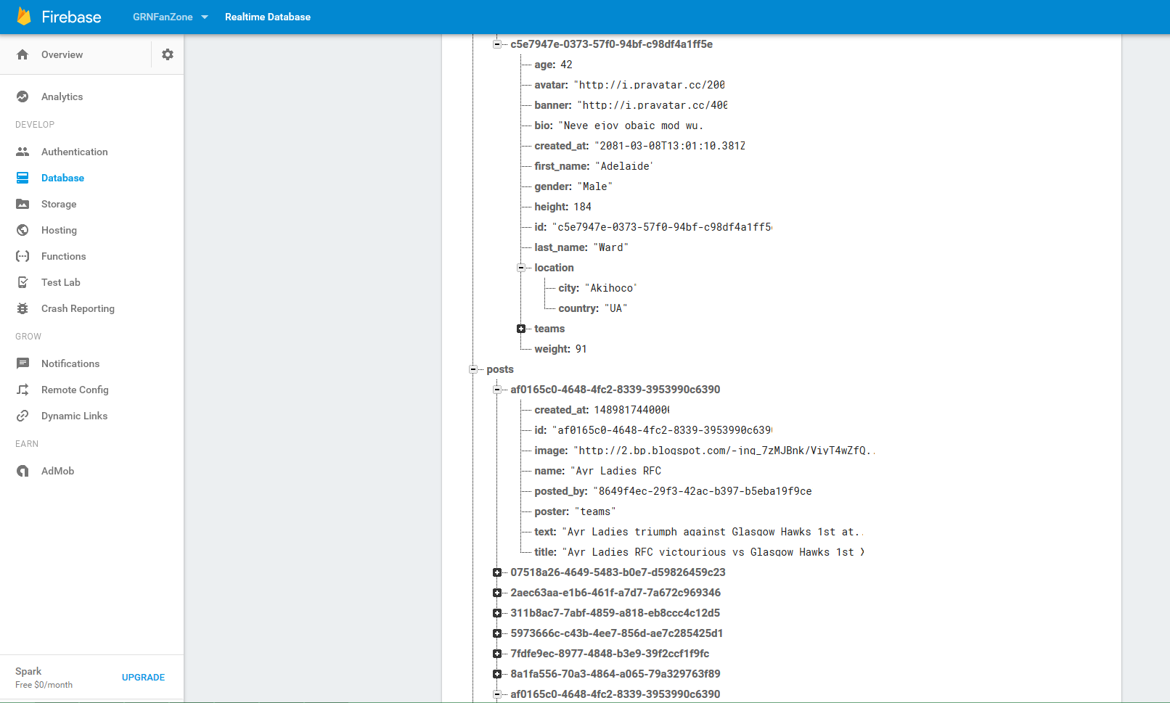
Firebase

Slide 9
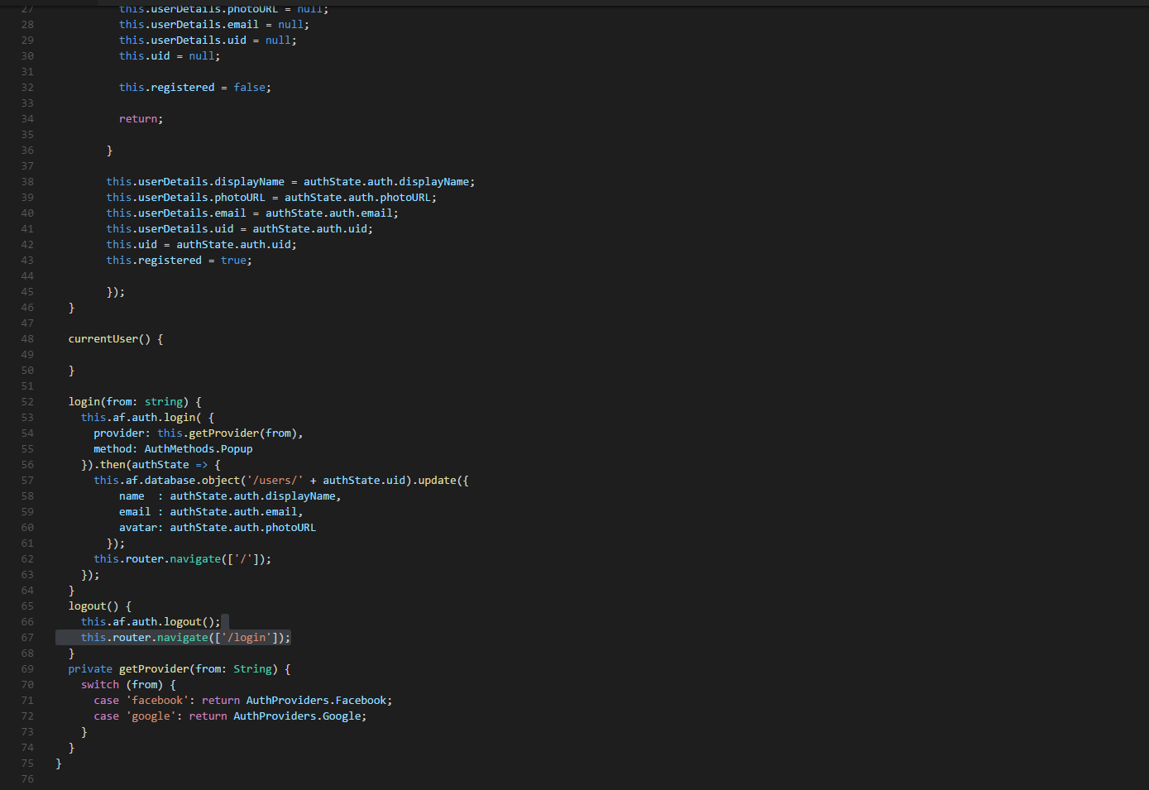
Angular2

Slide 10
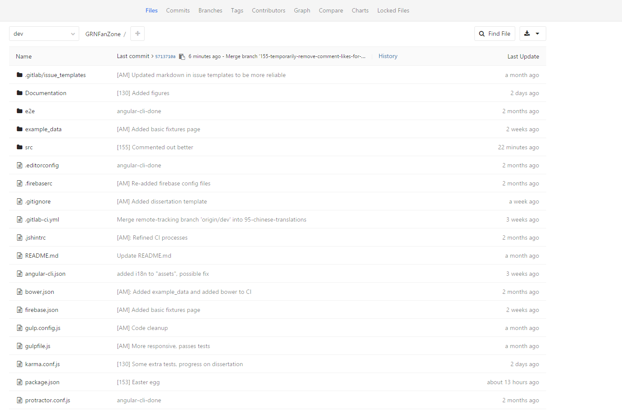
Gitlab

Slide 11
TECHNICAL FEATURES/CHALLENGES
Gitlab
Testing
TypeScript
Angular 2
Angular Fire
Bootstrap 4
Firebase
Bootstrap 3

Slide 12

Demo

Slide 13
FUTURE PLANS
Efficiency
Features
Searching
Dashboard
Redundant code
Media Posts
Event Pages
Personal Inbox

